Slide 1
Structure and Services
Module 2
ITSC205
Operating Systems Internals

Slide 2
Module Objectives
Describe operating system services.
Describe mechanisms to access operating system services
Explain how operating systems may be structured.
Analyze the system boot-up process.
Discuss the attack surface presented by modern operating systems.

Slide 3
Types of System Services
Program execution
I/O operation
File system manipulation
Communications
Error Detection
Resource Allocation
Accounting
Protection and Security

Slide 4
User Operating System Interface - CLI
CLI or Command Line interpreter allows direct command entry. sometimes implemented in kernel, sometimes by systems program
Shell is a program that interprets commands
Primarily fetches a command from user and executes it
Most common shells in Linux are: sh , Bash, csh
Each shell has its own environment (system variables) e.g PATH, SHELL, PS1, USERNAME, HOSTNAME ... etc
These variables can be accessed using env command or
echo $VARIABLE-NAME

Slide 5
User Operating System Interface - GUI
User-friendly desktop metaphor interface
Usually mouse, keyboard, and monitor
Icons represent files, programs, actions, etc
Various mouse buttons over objects in the interface cause various actions (provide information, options, execute function, open directory (known as a folder)
Many systems now include both CLI and GUI interfaces
Microsoft Windows is GUI with CLI “command” power shell
Apple Mac OS X is “Aqua” GUI interface with UNIX kernel underneath and shells available
Unix and Linux have CLI with optional GUI interfaces (CDE, KDE, GNOME)

Slide 6
Windows Management Instrumentation (WMI)
WMI is the core management-enabling technology for Windows that allows to manage windows objects
Built into Windows 7 and Windows Server 2008
WMI was added to address two short-comings in previous versions of NT:
Remote monitoring & management
Scripting – PowerShell

Slide 7
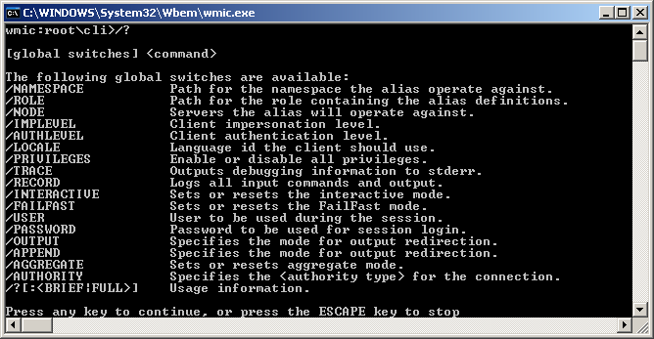
WMIC
Notes:
“Microsoft product screen shot(s) reprinted with permission from Microsoft Corporation.”

Slide 8
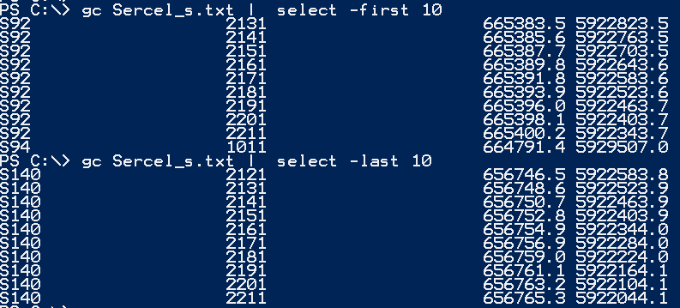
Windows Power Shell

Slide 9
Operating System Operations Kernel and User mode

Slide 10
Protection Mechanisms
Built into every component of the OS, and more!
Must distinguish between trusted and untrusted
The OS must control access to resources and enforce these controls!
Access Definition
Access Control
Error detection

Slide 11
Protection Mechanisms
Operation Modes: built into CPU to support protection
Dual-mode: user mode and kernel/privileged mode
Multimode: ring 0 (kernel) to ring 3 (user)
Kernel mode has unrestricted access to H/W
User mode has limited set of CPU instructions
User applications can request H/W, control is passed to the OS to execute privileged instructions
This allows the OS to maintain control over all the system resources

Slide 12
Kernel-Mode vs User-Mode
To ensure the integrity of the OS, the designers separated it into two modes: Kernel and User Mode
Mode bit provided by hardware. It distinguishes when system is running in user code mode bit=1or kernel code mode bit =0
Kernel mode (supervisor, kernel, privileged, system mode). Kernel space is strictly reserved for running the kernel, kernel extensions, and most device drivers
Can execute all machine instructions
Can reference all memory locations
User mode User space is the memory area where all user mode applications work and this memory can be swapped out when necessary.
Can only execute a subset of instructions
Can only reference a subset of memory
locations

Slide 13
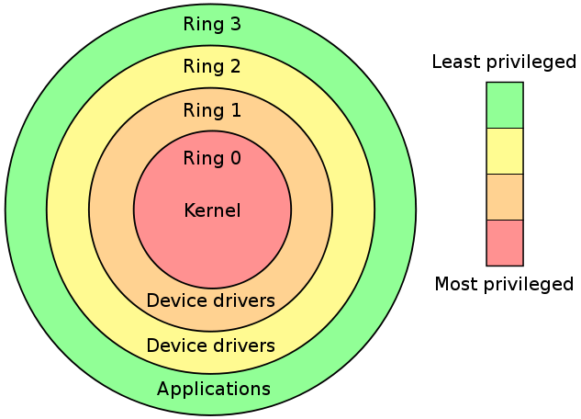
Layered Operating system
ITSC205 Operating Systems Internals.
Notes:
Permission is granted to copy, distribute and/or modify this document under the terms of the GNU Free Documentation License, “

Slide 14
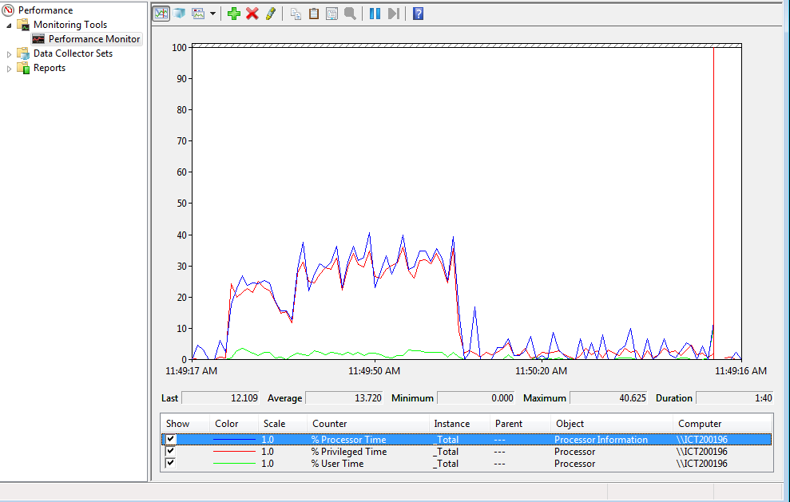
Privilege and User Time
Processor Time
Privileged Time
User Time
ITSC205 Operating Systems Internals.

Slide 15
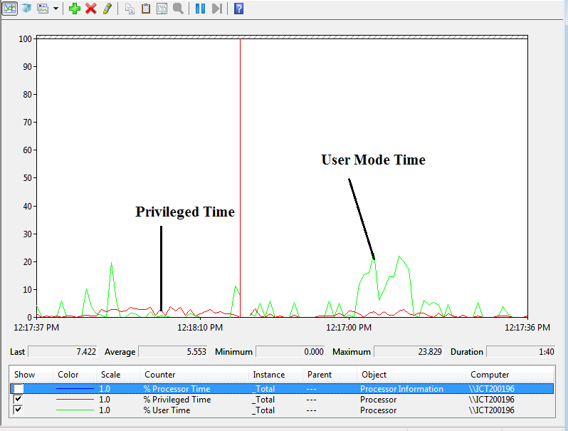
Privileged and User Time
ITSC205 Operating Systems Internals.

Slide 16
Linux Kernel
https://github.com/torvalds/linux

Slide 17
Kernel Architectures
Application
Windows
User Mode
Kernel Mode
System Services
Device
Drivers
Process Management, Memory Management,
I/O Management, etc.
Win32
Windowing
Application
Hardware Dependent Code
Linux
X-Windows
User Mode
Kernel Mode
System Services
Process Management, Memory Management,
I/O Management, etc.
Device
Drivers
Hardware Dependent Code
ITSC205 Operating Systems Internals.

Slide 18
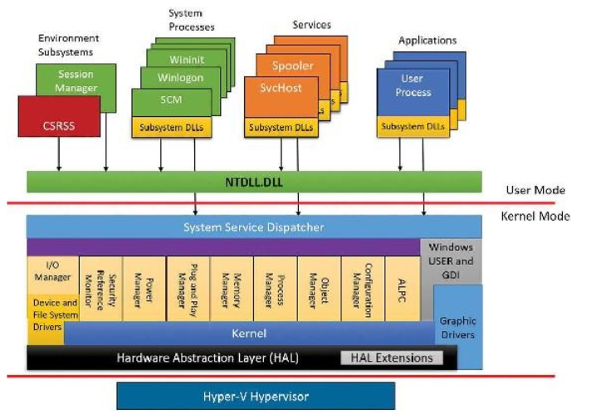
Windows Architecture
ITSC205 Operating Systems Internals.

Slide 19
Accessing System Services
Every system service requires the use of a protected system resource
Only the OS is allowed to execute privileged instructions in kernel mode
User mode applications can make a request to the OS
The OS provide an interface to its services
This interface, commonly known as system calls, allows requests to system resources to be made by user-level code

Slide 20
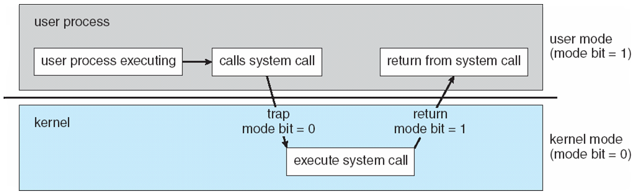
Transition from User to Kernel Mode
Timer to prevent infinite loop / process hogging resources
OS traps instruction and validates arguments to system calls
Set interrupt after specific period
Operating system decrements counter
When counter zero generate an interrupt
Set up before scheduling process to regain control or terminate program that exceeds allotted time
ITSC205 Operating Systems Internals.

Slide 21
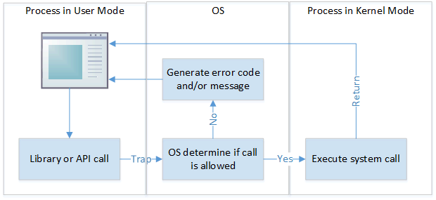
System Calls

Slide 22
Operating system structure

Slide 23
Implementation
Much variation
Early OSes in assembly language
Then system programming languages like Algol, PL/1
Now C, C++
Actually usually a mix of languages
Lowest levels in assembly
Main body in C
Systems programs in C, C++
Scripting languages like PERL, Python, shell scripts
More high-level language easier to port to other hardware
But slower
Emulation can allow an OS to run on non-native hardware

Slide 24
Kernel Implementation
1. Monolithic Kernel
All operating system’s functions & drivers are compiled into one large kernel
Fast & efficient
More work to accommodate hardware changes
Changes in the code can damage the kernel
https://en.wikipedia.org/wiki/Monolithic_kernel

Slide 25
Kernel Implementation
2. Microkernel
Kernel has minimal functionality
File systems, Device drivers and Applications Programs are modules in user mode
Microkernel implements message passing technique to communicate programs running in user mode
3. Modules – loadable kernel modules
The most common design in modern OS
4. Hybrid Structures. It combines above structures
Monolithic, Microkernel and Modules Kernel
https://en.wikipedia.org/wiki/Monolithic_kernel
Notes:
Is Windows a microkernel-based OS?
No – not using the academic definition (OS components and drivers run in their own private address spaces, layered on a primitive microkernel)
All kernel components live in a common shared address space
Therefore no protection between OS and drivers
Why not pure microkernel?
Performance – separate address spaces would mean context switching to call basic OS services
Most other commercial OSs (Unix, Linux, VMS etc.) have the same design
But it does have some attributes of a microkernel OS
OS personalities running in user space as separate processes
Kernel-mode components don't reach into one another’s data structures
Use formal interfaces to pass parameters and access and/or modify data structures
Therefore the term “modified microkernel”

Slide 26
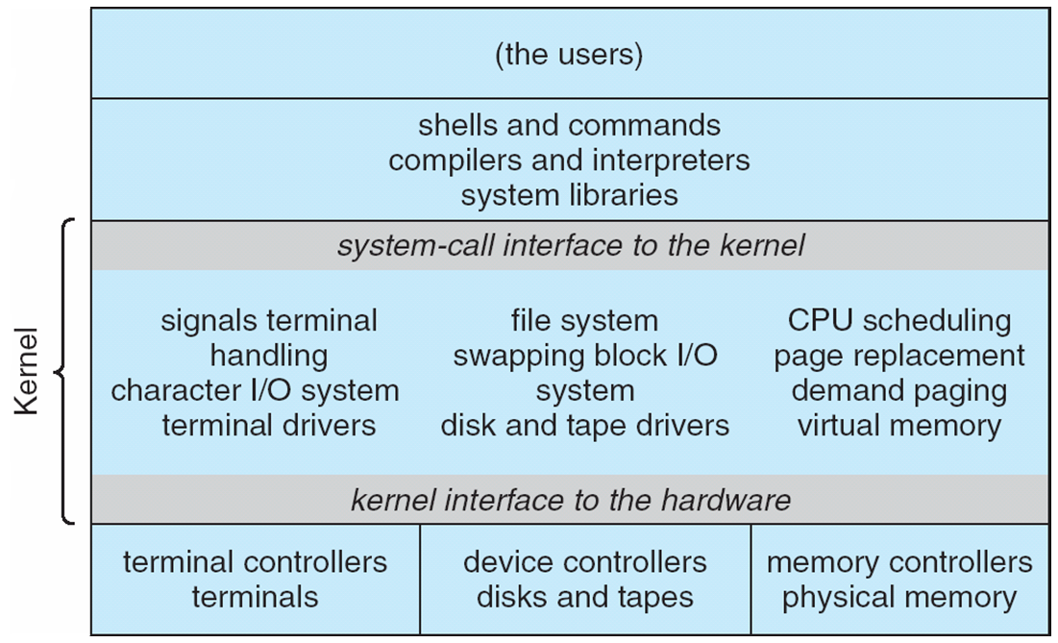
Monolithic Unix System Structure
ITSC205 Operating Systems Internals.

Slide 27
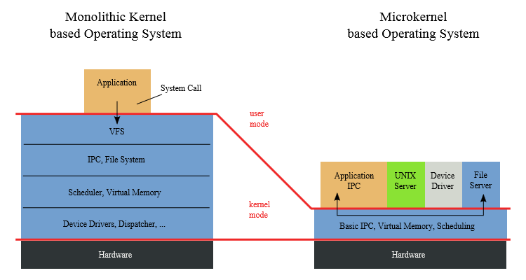
Monolithic and Microkernel

Slide 28
Microkernel System Structure

Slide 29
Microkernel System Structure
Benefits:
Easier to extend the operating system
Easier to port the operating system to new architectures
More reliable (less code is running in kernel mode)
More secure
Disadvantage:
Performance is affected due to increased system-function overhead. More traps needed due to message passing
E.g. Darwin kernel component of MacOs , iOs and QNX Neutrino real time operating system provides services for message passing. QNX implemented in vehicles such as Ford
https://en.wikipedia.org/wiki/QNX

Slide 30
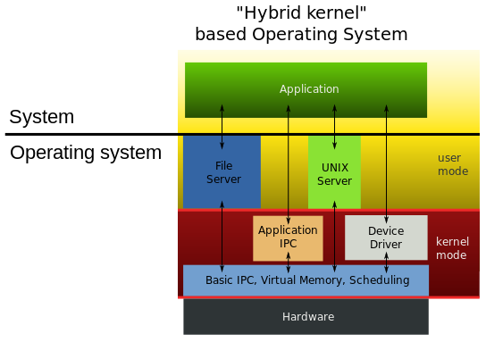
Structure of the OS
Hybrid (Modular) kernels
Notes:
Image source: https://commons.wikimedia.org/wiki/File:OS-structure2.svg

Slide 31
Hybrid Systems
Hybrid kernel structures combines multiple approaches to address performance, security, usability needs. The following are examples of hybrid systems:
Linux and Solaris are monolithic because the OS is in a single address space but they are also modular kernels because modules can be loaded dynamically when needed.
Windows is mostly monolithic and layer kernel for different subsystems
Apple Mac OS X has a hybrid structure: Layers and Modules
It is a layered system. Aqua UI , Services and Cocoa programming environment and kernel environment
The bottom layer consists of a I/O kit and dynamically loadable modules (called kernel extensions)

Slide 32
Mac OS X Structure

Slide 33
iOS
Apple mobile OS for iPhone, iPad
Structured on Mac OS X
Does not run OS X applications natively
Also runs on different CPU architecture (ARM vs. Intel)
Cocoa Touch Objective-C API for developing apps
Media services layer for graphics, audio, video
Core services provides cloud computing, databases
Core operating system, based on Mac OS X kernel

Slide 34
Modules
Most modern operating systems implement loadable kernel modules
Main routines (modules) can be built directly into the kernel and other modules can be loaded dynamically while the kernel is running
Each module is loadable as needed within the kernel
It uses object-oriented approach
Each core module is separated
Each module talks to the others over known interfaces

Slide 35
Modules
Linux implements loadable kernel modules (LKM) for drivers and file systems
Linux commands to manage modules:
lsmod --- displays current loaded kernel modules
insmod --inserts a module into the kernel
rmmod – remove module from kernel
In Windows verify loaded modules using system information → Software Environment → Loaded Modules

Slide 36
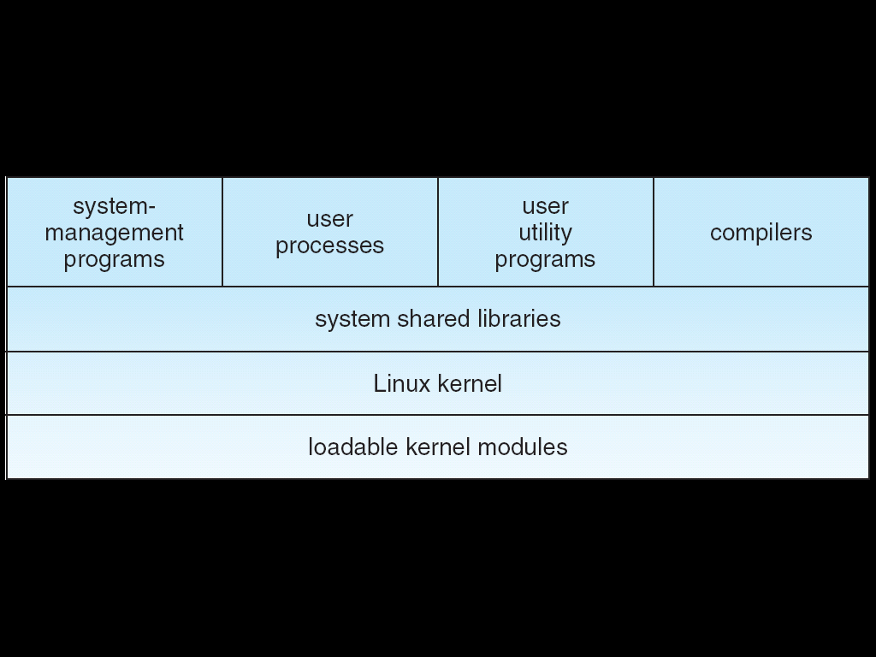
Linux Kernel
Linux /usr/src directory contains the kernel source, header-files and documentation.

Slide 37
Linux Kernel .conf file
Find the kernel version uname –r
Access /usr/src/linux-headers-3.13.0-164-generic (this is the path where makefile and other kernel configuration files are located)
make menuconfig will display kernel configuration file .config

Slide 38
Linux OS
“Most large organizations rely on Linux to run websites, proxy network traffic and store valuable data. Linux runs nearly all of the top 1 million websites, 75% of all web servers, 98% of the world’s supercomputers and 75% of major cloud service providers” (Netcraft, 2019, Linux Foundation, 2020).

Slide 39
Windows -Design Principles
Windows is monolithic and implements layered architecture with loadable drivers for I/O and file systems. Drivers/Libraries can be added dynamically while the system is running.

Slide 40
Android
Developed by Open Handset Alliance (mostly Google)
Open Source
Similar stack to IOS
Based on Linux kernel but modified
Provides process, memory, device-driver management
Adds power management
Runtime environment includes core set of libraries and ART virtual machine
Apps developed in Java plus Android API
Java class files compiled to Java bytecode then translated to executable by ART (Application Run Time)
Libraries include frameworks for web browser (webkit), database (SQLite), multimedia, smaller libc

Slide 41
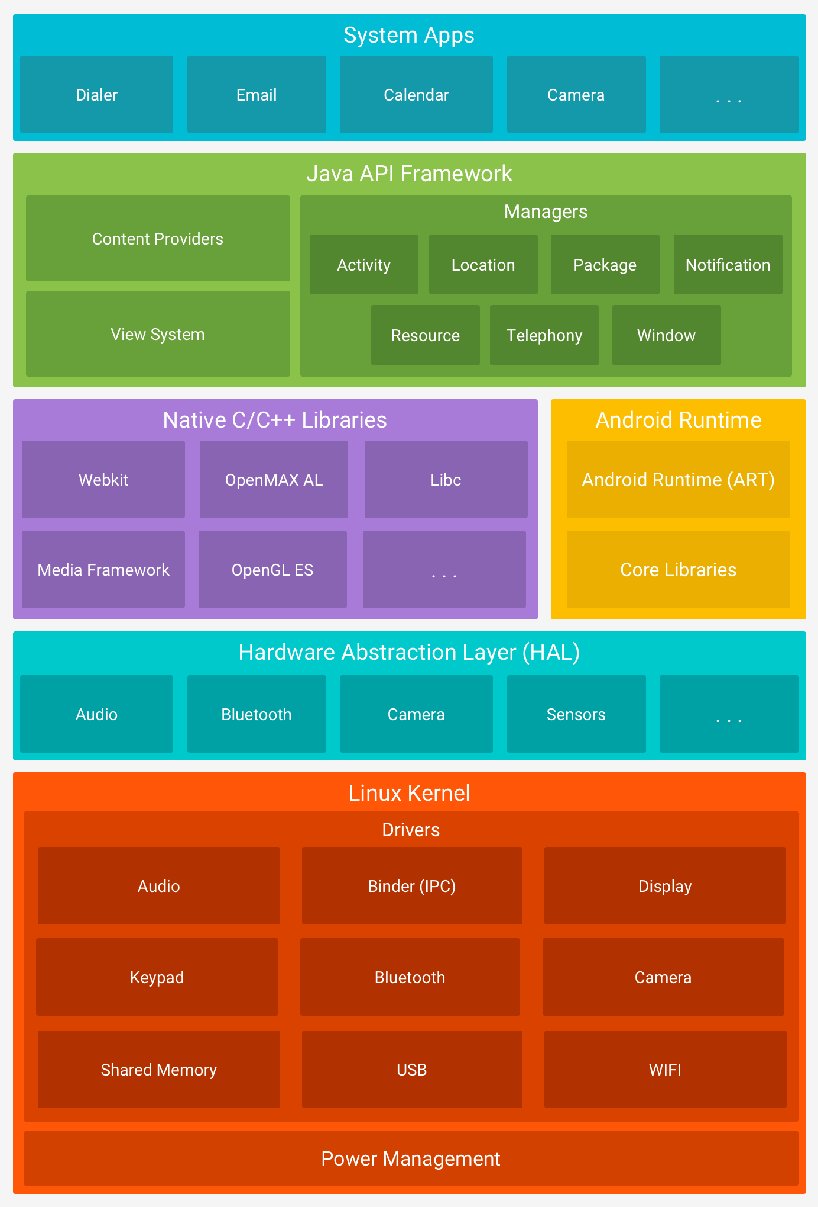
Android Architecture
https://developer.android.com/guide/platform

Slide 42
Virtual Machines
Recall that Hypervisor or Virtual Machine Manager (VMM) on the host machine is responsible for the guest OSes
Type 0: VMM runs directly on H/W
Type 1: OS-level VMM
Type 2: S/W VMM
Para-virtualization –It passes tasks to host machine. Virtual machines can make direct calls to host hardware by passing VMM
Programming-environment virtualization
Emulators

Slide 43
Virtual Machines
Trap-and-emulate: guest privileged instruction causes trap to VMM, VMM executes on behalf of the guest (emulates)
Binary Translation: VMM must look for “special instruction” which behaves differently in user vs. kernel mode
H/W Assistance: CPU have host/root and guest/nonroot modes, all guest privileged instructions go through the VMM

Slide 44
Hyper-V Hypervisor
Hypervisor is the first component initialized with virtual secure mode (VSM ) enabled.
Hypervisor is used to provide hardware virtualization features for running separate virtual machines and to provide virtual trust levels (VTL)
In VSM mode the layered privileged system has two implementations:
Normal World – VTL 0
Secure World – VTL 1
Within these worlds we find user mode and kernel mode

Slide 45
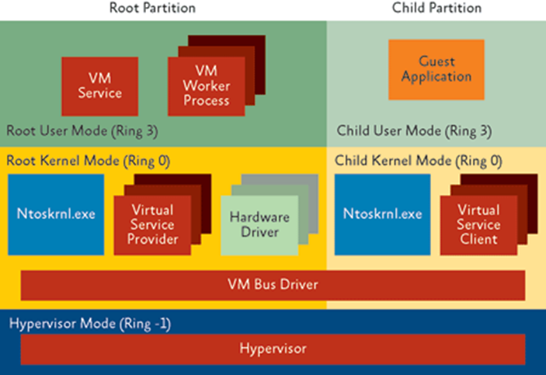
Hyper-V Architecture
ITSC205 Operating Systems Internals.

Slide 46
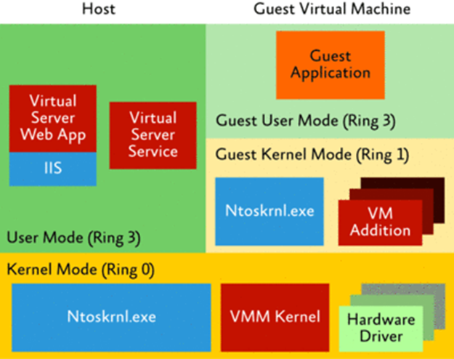
Host Machine Virtualization

Slide 47
Attack Surface
Vulnerabilities accessible to an attacker
Entry points into the system
Protection vs. Security
Authorization (access control) vs. Authentication
The OS is the base for all applications (the Trusted Computing Base – TCB)
To protect resources, control various policies of access supported by the mechanisms
Notes:
OS can only provide protection and security with hardware support, including memory protection, processor execution modes (user/kernel, rings), and only allowing privileged instructions to be executed in kernel mode/ring 0.

Slide 48
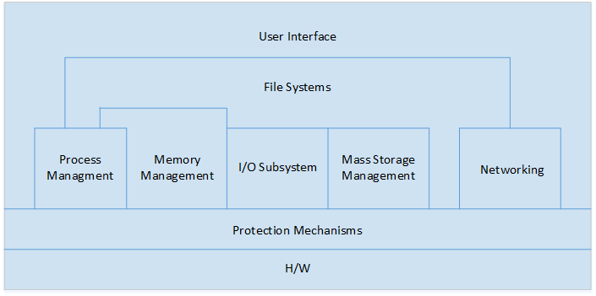
Attack Surface
Review the OS components, what are the entry points?
Notes:
UI of course, the biggest layer exposed… what are some ways to attack the UI? The concept of “Trusted Path” – are you sure you’re logging in (and giving your password) to the real login screen or another app? This is the first entry point! What can you get to from here?
FS/storage: most common target, with all the valuable info!
Processes: how do you run your own program? And not get caught!
Memory: if you can do whatever you want with memory, you can do whatever you want with the system!
I/O: intercepting input and controlling output
Networking: review your networking courses!
Protection: bypassing mechanisms in place to gain more access (privilege escalation)

Slide 49
Attack Surface
Security at the OS level:
Authentication
Authorization
Audit
Mandatory and discretionary Access Controls
OS data protection
Complete mediation, tamper-proof, correctness
Trusted path
Notes:
Authentication- Winlog.exe - Lsass.exe -Plaint text credentials - It can be capture by keylogger install by attacker via pishing mail or exploiting a vulnerable browser – web page scripting. Lsalso.exe – encrypted credentials . Smartcard stronger authentication than passwords
Trusted Path – Prevent Trojans horse programs from intercepting user’s names and passwords. Ctrl-Alt-Del cannot be intercepted by non-priviledge application. Malicious program can present a fake logon dialog box
Authorization- Access Control – ACL ( set of rules attached to an object) Some are mandatory or discretionary access control. E.g in Linux permissions assign to owner, groupt others to a file rwxr--r--
Complete Mediation every access to every object must be check for authorization . I f a step is no checked for e.g between when access privileges are checked and when a file is open , an attacker can for e.g. A dummy file /etc/passwd with attacker permissions and continue with the attack.
Audit – Assess system physical configuration and environmental. Measure system performance against defined criteria. Kernel-mode is always allow to generate audit events

Slide 50
Windows Patch-Guard -KPP (Kernel Mode Protection)
Technique implemented in Windows checks unwanted code. KPP check certain kernel components such as:
System Service Descriptor Table( SSDT) table that contains an array of pointers for each system call handler. Rootkit could modify input or output of calls from user mode and hide processes, files and registry keys
Global Descriptor Table(GDT) CPU hardware protection for the implementation of ring privilege levels( ring 0 and 3)
Process and module list- Tools that displays active processes and loaded drivers

Slide 51
Windows Patch-Guard -KPP (Kernel Mode Protection)
Interrupt Descriptor Table (IDT) –Table read by CPU to deliver interrupt vectors to the correct handling routine. Malicious drivers could intercept file I/Os directly at the interrupt level, or hook page faults to hide contents of memory. Rootkits could hook the INT2E handler to hook all system calls from a single point.
Windows Internals Sixth edition part 1 Page

Slide 52
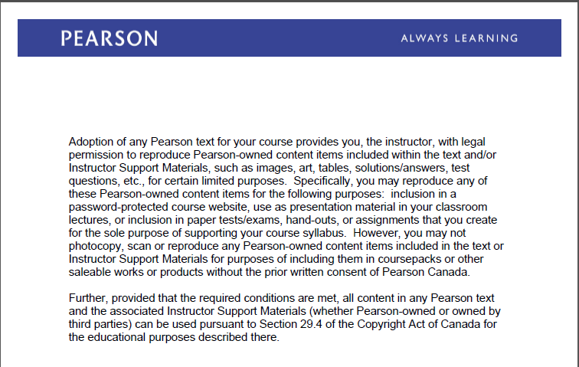
Text Book Slides – Copy Right

